Slide 1


Chapter Sixteen
Unemployment: Meaning, Measurement and Canada’s Experience
Prepared by Dr. Mir Ahasan Kabir
York University

Slide 2
Learning Objectives
Explain how unemployment and the unemployment rate are defined and measured.
Explain why the measurement of unemployment is often controversial and describe alternative measures that can be used.
Summarize the salient features of Canada’s unemployment experience and how it compares to those of other developed countries.
Define the labour force participation rate and the employment rate and explain why these measures are often used in addition to the unemployment rate to provide a complete picture of the state of the labour market.
Explain the meaning of the incidence and duration of unemployment and describe how each contributes to the extent of unemployment.
Describe the dynamic nature of the Canadian labour market and explain the implications of this feature for understanding movements in unemployment.
© 2021 MCGRAW-HILL EDUCATION LTD.
16 - <number>

Slide 3
Main Questions
How is the unemployment rate measured? Who is considered to be unemployed?
How does Canada’s unemployment experience compare to that of other countries?
How do the incidence and duration of unemployment separately contribute to the overall unemployment rate?
How long is a typical Canadian unemployed?
Does this vary across groups in the population?
Does the unemployment rate accurately reflect the amount of hardship felt by the jobless?
© 2021 MCGRAW-HILL EDUCATION LTD.
16 - <number>

Slide 4
Measuring Unemployment
Unemployment:
  Those who are not currently employed and who indicate by their behaviour that they want to work at the prevailing wages and working conditions
Labour Force Survey (LFS):
  Conducted monthly by Statistics Canada
  People categorized as unemployed if they did not work but were actively searching for work
  People categorized as employed if they did any work for a pay
  Employed plus unemployed make the labour force
  Unemployment rate is defined as the number of unemployed divided by the labour force
© 2021 MCGRAW-HILL EDUCATION LTD.
16 - <number>

Slide 5
Canadian Experience
1929: The Great Depression unemployment rate soared to 20%.
During the World War II the unemployment rate fell.
In the recession periods of 1957–58, 1974–75, and 1981–82 the unemployment rate increased.
After a brief economic slowdown in 2001, the Canadian economy experienced strong growth in the first part of the 21st century. By 2006, the unemployment rate had fallen to 6.0 percent, its lowest level since the early 1970s.
The global financial crisis that began in 2008 resulted in a deep recession in many countries. Canada’s economic downturn was less severe but the unemployment rate rose to 8.3 percent in 2009.
Since 2009, Canada’s unemployment rate has gradually declined.
© 2021 MCGRAW-HILL EDUCATION LTD.
16 - <number>

Slide 6
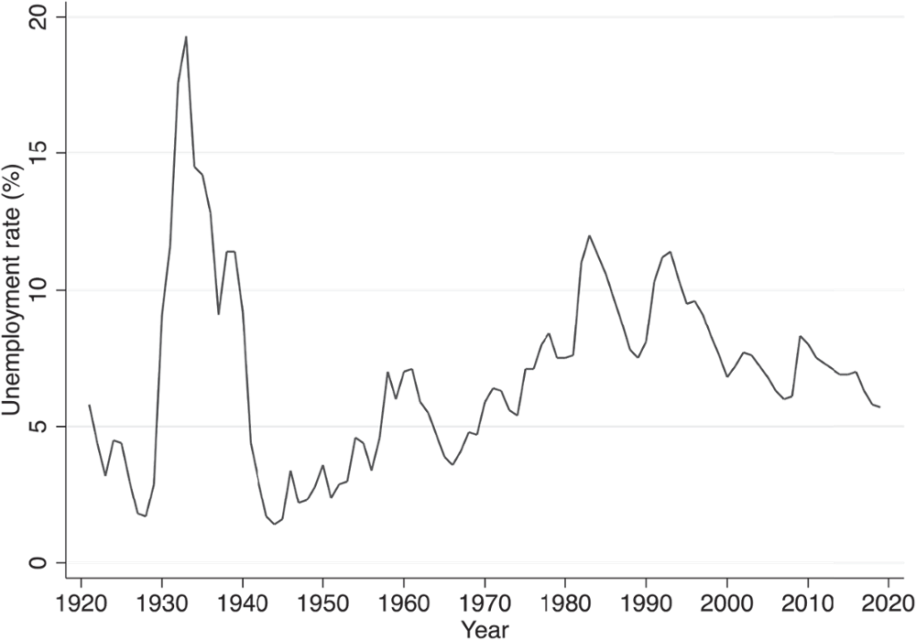
Canadian Experience
Figure 16.1 A Century of Unemployment in Canada
© 2021 MCGRAW-HILL EDUCATION LTD.
16 - <number>

Slide 7
Canadian Experience
Alternative Measures of Labour Force Activity
Unemployment rate is used to measure the aggregate labour market activity and the degree that the labour force is utilized
The employment and labour force participation rates focus on the fraction of the working age population that are employed and in the labour force respectively
Unemployment rate measures the fraction of the labour force that is out of work and searching for a job
© 2021 MCGRAW-HILL EDUCATION LTD.
16 - <number>

Slide 8
Canadian Experience
Table 16.1 Labour Force Participation, Employment, and Unemployment, Canada, 1946–2019ª
Year | Labour Force Participation Rate | Employment Rate | Unemployment Rate | Rate of Growth of Employment^{b}
1946 | 55.0 | 53.1 | 3.4
1956 | 53.5 | 51.7 | 3.4 | 1.8
1966 | 55.1 | 53.1 | 3.6 | 2.5
1973 | 59.7 | 56.4 | 5.6 | 3.0
1981 | 65.0 | 60.0 | 7.6 | 3.2
1989 | 67.2 | 62.1 | 7.5 | 1.8
2000 | 65.9 | 61.4 | 6.8 | 1.2
2008 | 67.6 | 63.4 | 6.1 | 1.8
2019 | 65.7 | 62.0 | 5.7 | 1.0
© 2021 MCGRAW-HILL EDUCATION LTD.
16 - <number>

Slide 9
Canadian Experience
International Differences in Unemployment
In the 1950s, unemployment rates were higher in the U.S than those in Australia and Japan
With the first OPEC oil shock in 1973, unemployment rose in a few European countries
During the 1990s further increases in unemployment took place in France, Germany, and Italy
Since 2000, unemployment rates have remained low in English speaking countries
The worldwide financial crisis and the associated 2008-09 recession resulted in dramatically higher unemployment in many advanced economies.
© 2021 MCGRAW-HILL EDUCATION LTD.
16 - <number>

Slide 10
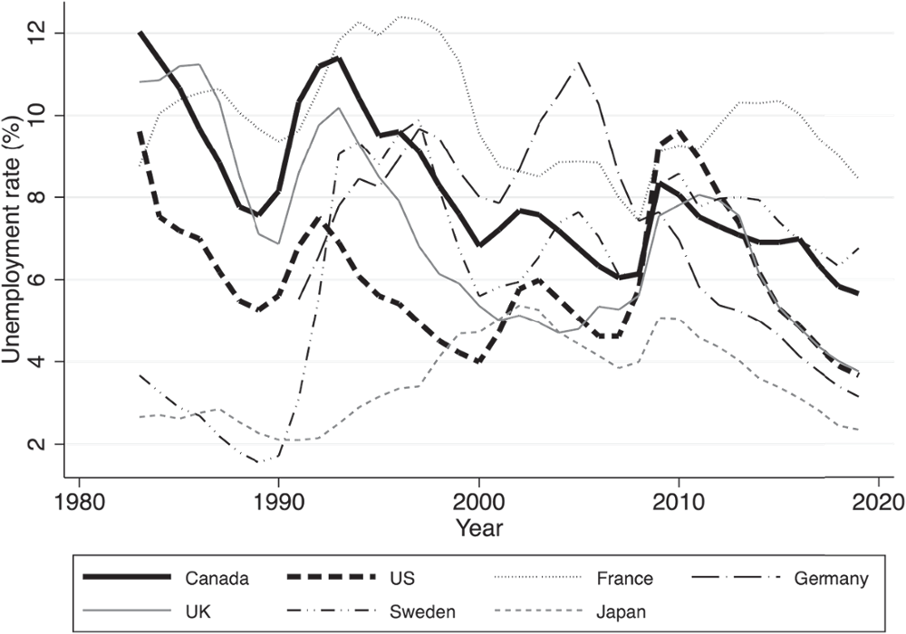
Canadian Experience
Figure 16.2 Unemployment rates across selected countries
© 2021 MCGRAW-HILL EDUCATION LTD.
16 - <number>

Slide 11
Canadian Experience
Hidden Unemployment
Individuals may be without work and yet they desire to work but are not classified as unemployed
During recession where few jobs are available, the phenomenon of the discouraged worker appears
Discouraged workers are not employed and yet are not seeking work because they think that no work is available
The number of discouraged workers increases during a recession
© 2021 MCGRAW-HILL EDUCATION LTD.
16 - <number>

Slide 12
Labour Force Dynamics
Labour Market Stocks and Flows:
Flows that occur each month between the labour force of employed, unemployed, and not in the labour force
On average every month 235,000 unemployed workers obtain jobs
190,000 workers lost or left jobs and joined the pool of job searchers
Average net monthly flow was 45,000
The probability of an unemployed worker becoming employed is 0.22
© 2021 MCGRAW-HILL EDUCATION LTD.
16 - <number>

Slide 13
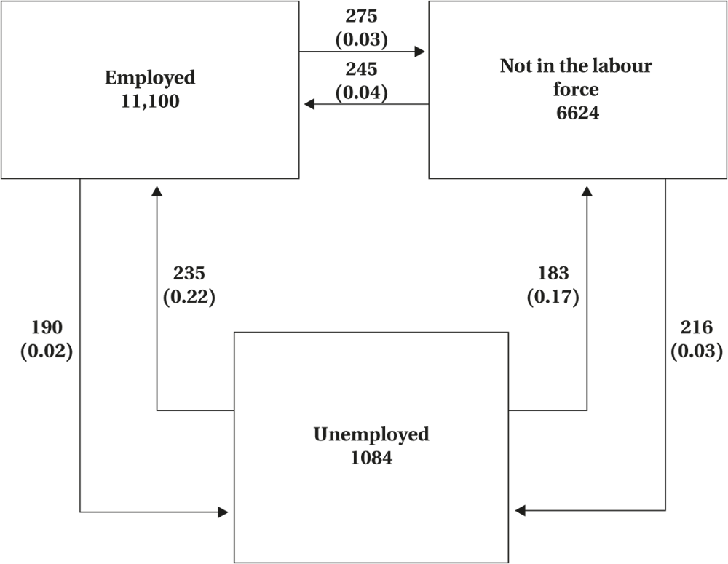
Labour Force Dynamics
Figure 16.3 Labour Market Stocks and Flows, 1976–1991
© 2021 MCGRAW-HILL EDUCATION LTD.
16 - <number>

Slide 14
Labour Force Dynamics
Table 16.2 Decomposition of Unemployment by Reason, 2005–2019
 |  | Reason for Separation
 |  | Job Losers (%)
 | National Unemployment Rate (%) | Permanent | Temporary Layoffs | Job Leavers (%) | New Entrants and Re-entrants (%)
2005 | 6.8 | 28 | 7 | 10 | 42
2006 | 6.3 | 26 | 8 | 11 | 42
2007 | 6.0 | 27 | 7 | 11 | 43
2008 | 6.1 | 29 | 7 | 11 | 44
2009 | 8.3 | 33 | 8 | 8 | 40
2010 | 8.1 | 30 | 6 | 6 | 42
2011 | 7.5 | 27 | 5 | 9 | 43
2012 | 7.3 | 26 | 5 | 8 | 45
2013 | 7.1 | 28 | 5 | 8 | 44
2014 | 6.9 | 28 | 5 | 9 | 44
2015 | 6.9 | 29 | 5 | 8 | 44
2016 | 7.0 | 30 | 4 | 8 | 44
2017 | 6.3 | 27 | 4 | 8 | 47
2018 | 5.8 | 25 | 4 | 9 | 48
2019 | 5.7 | 26 | 4 | 9 | 49
© 2021 MCGRAW-HILL EDUCATION LTD.
16 - <number>

Slide 15
Labour Force Dynamics
Incidence and Duration of Unemployment:
The incidence of unemployment: is the proportion of individuals who become unemployed in any period
The duration of unemployment: is the length of time spent in the unemployment state before obtaining employment or leaving the labour force
Incidence: measures the probability of a member of the group becoming unemployed
Duration: measures the length of time the individual can be expected to remain unemployed
© 2021 MCGRAW-HILL EDUCATION LTD.
16 - <number>

Slide 16
Labour Force Dynamics
Incidence and Duration of Unemployment:
Incidence of unemployment: measured as a fraction of labour force
Amount of unemployed is affected by both incidence and duration
UR = I (incidence) X D (duration)
© 2021 MCGRAW-HILL EDUCATION LTD.
16 - <number>

Slide 17
Labour Force Dynamics
Table 16.3 Incidence and Duration of Unemployment by Age and Sex, Canada, 2019
Sex | Age Group | Unemployment Rate | Incidence Rate | Duration (Months) | Unemployed > 6 Months (%)
Men | 15–24 | 12.3 | 6.1 | 2.0 | 7.5
 | 25–44 | 5.3 | 1.9 | 2.8 | 14.8
 | 45 + | 4.8 | 1.4 | 3.4 | 23.6
 | All | 6.0 | 2.3 | 2.7 | 15.8
Women | 15–24 | 9.7 | 5.1 | 1.9 | 5.9
 | 25–44 | 5.3 | 1.9 | 2.8 | 13.2
 | 45 + | 4.2 | 1.3 | 3.3 | 22.1
 | All | 5.3 | 2.1 | 2.5 | 14.2
© 2021 MCGRAW-HILL EDUCATION LTD.
16 - <number>

Slide 18
Labour Force Dynamics
Changing Perspectives on Unemployment
The data collected to date leads to the following conclusions:
The labour force is highly dynamic
About half the flow into unemployment is due to individuals losing their jobs
Even in 2010 (a time of above-normal unemployment) the average duration of unemployment was approximately three months, with only about one-fifth of all unemployment spells lasting more than six months.
The age groups with highest unemployment rate have lowest duration, but the highest incidence of unemployment
© 2021 MCGRAW-HILL EDUCATION LTD.
16 - <number>

Slide 19
Labour Force Dynamics
Table 16.4 International Differences in Long-Term Unemployment
 | Long-Term Unemployment as a Percentage of Total Unemployment
 | 1999 | 2019
 | 12 Months and Over | 12 Months and Over
Canada | 11.7 | 8.5
France | 40.4 | 38.8
Germany | 51.8 | 38.1
Japan | 22.4 | 32.3
Sweden | 30.1 | 12.1
United Kingdom | 29.6 | 25.1
United States | 6.8 | 12.7
© 2021 MCGRAW-HILL EDUCATION LTD.
16 - <number>

Slide 20
Unemployment Rate as a Summary Statistic
Unemployment rate is widely used as an economic indicator of:
Aggregate state of the economy
Tightness/Looseness of the labour market
Measure of the amount of unutilized labour supply
Increasing in periods of low or negative economic growth
Measures the extent of hardship in an economy, region, or time period
© 2021 MCGRAW-HILL EDUCATION LTD.
16 - <number>

Slide 21
Chapter Summary
Unemployment definition and measures
Canadian experience: history of events
Hidden unemployment: timing, causes, and consequences
Labour market stock and flows followed by statistics
Incidence and duration of unemployment plus research findings
Unemployment rates as a summary statistic
© 2021 MCGRAW-HILL EDUCATION LTD.
16 - <number>

